Slide 1



Data Ethics and Case Studies
Notes:
5. **Data Ethics and Case Studies (15 mins)**
- We will discuss ethics and look at cyber case studies.
- Topics:
- Data Ethics
- Cyber Case Studies

Slide 2
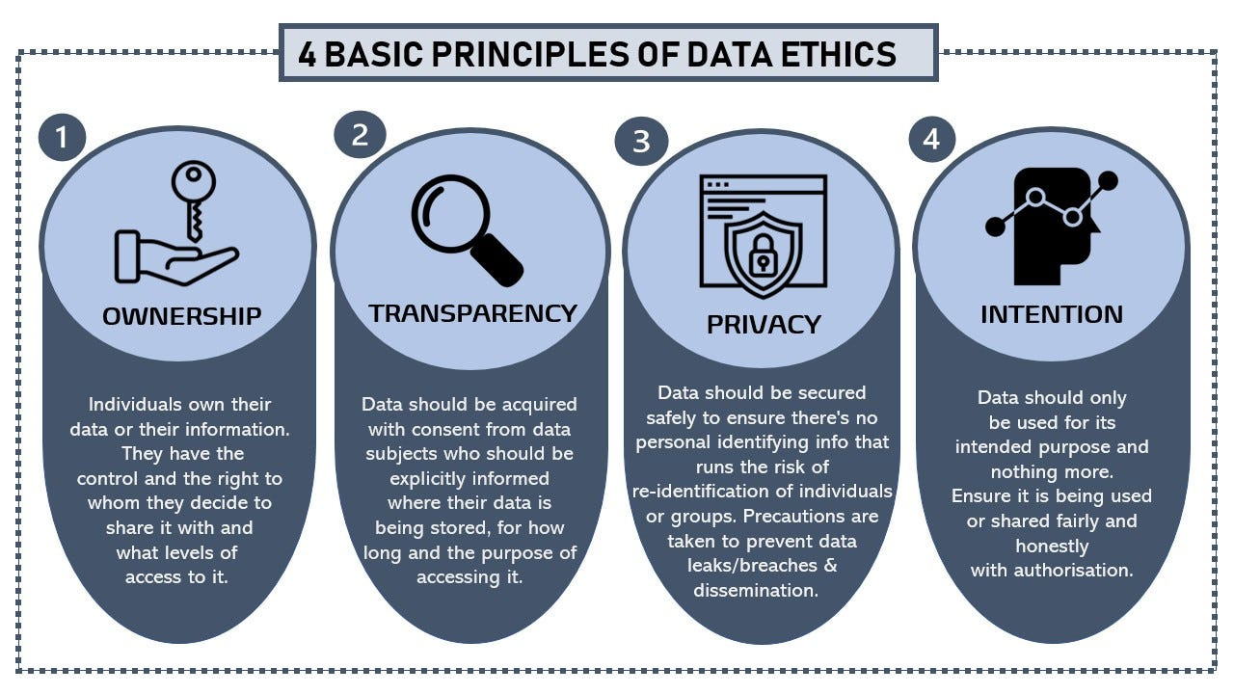
https://medium.com/@tapaita.n.kalamafoni/why-should-you-care-about-data-ethics-dbee9b85a6be

Slide 3
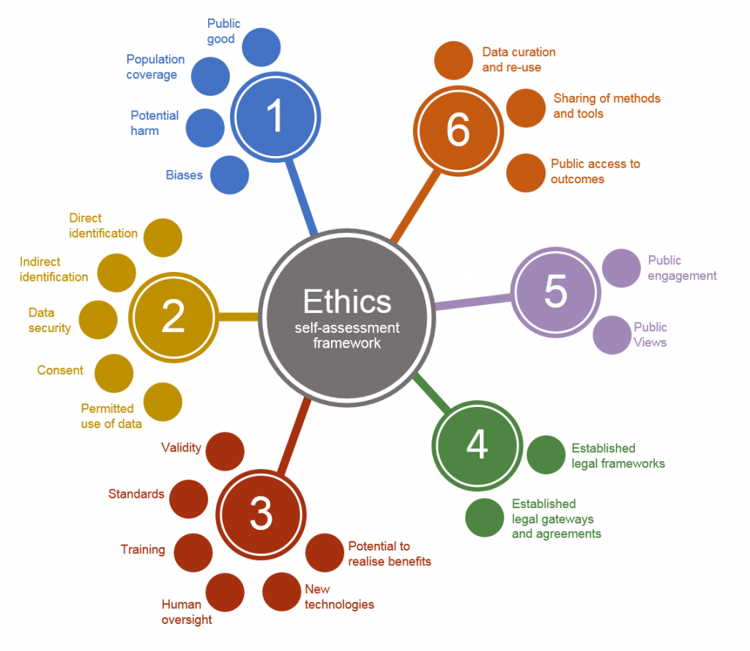
https://uksa.statisticsauthority.gov.uk/the-authority-board/committees/national-statisticians-advisory-committees-and-panels/national-statisticians-data-ethics-advisory-committee/ethics-self-assessment-tool/

Slide 4
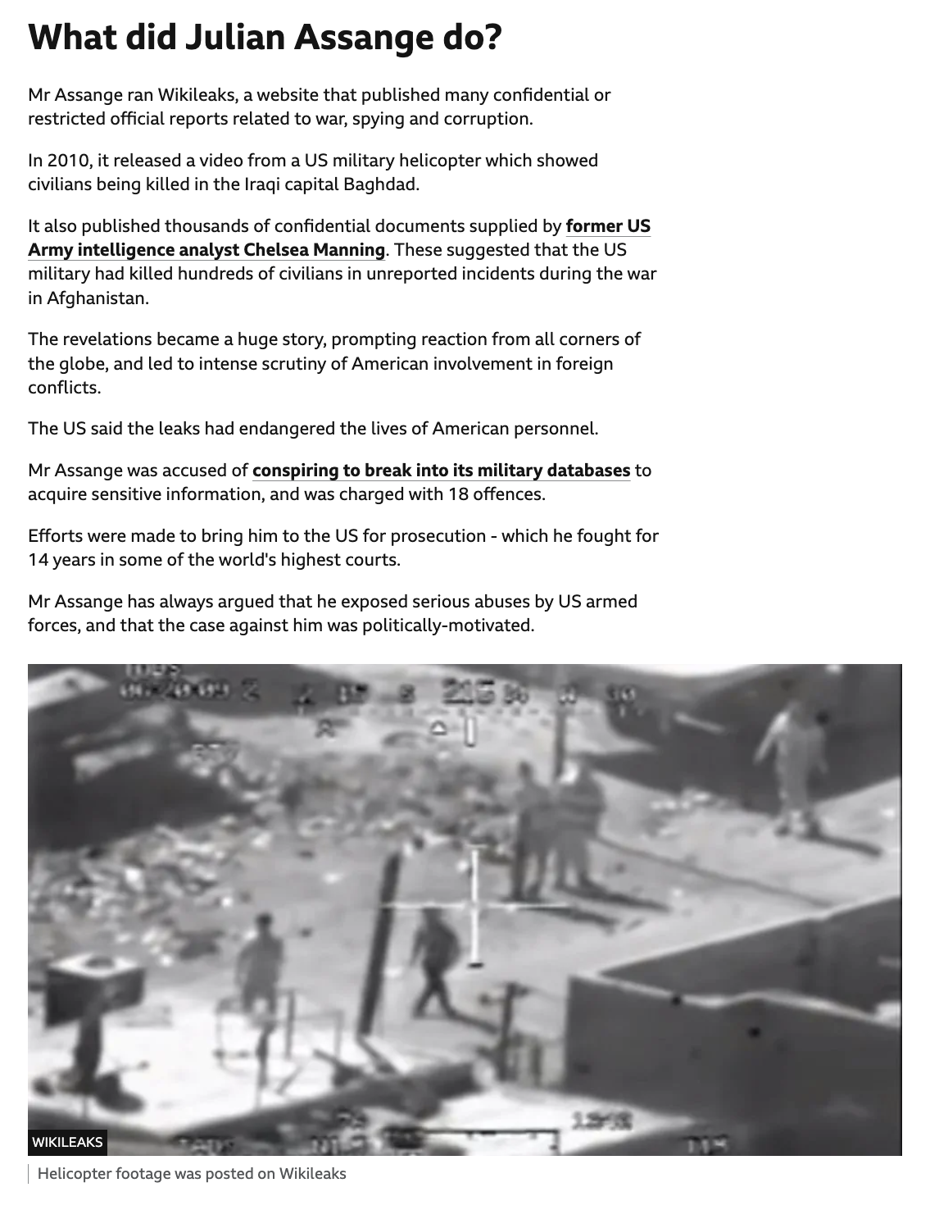
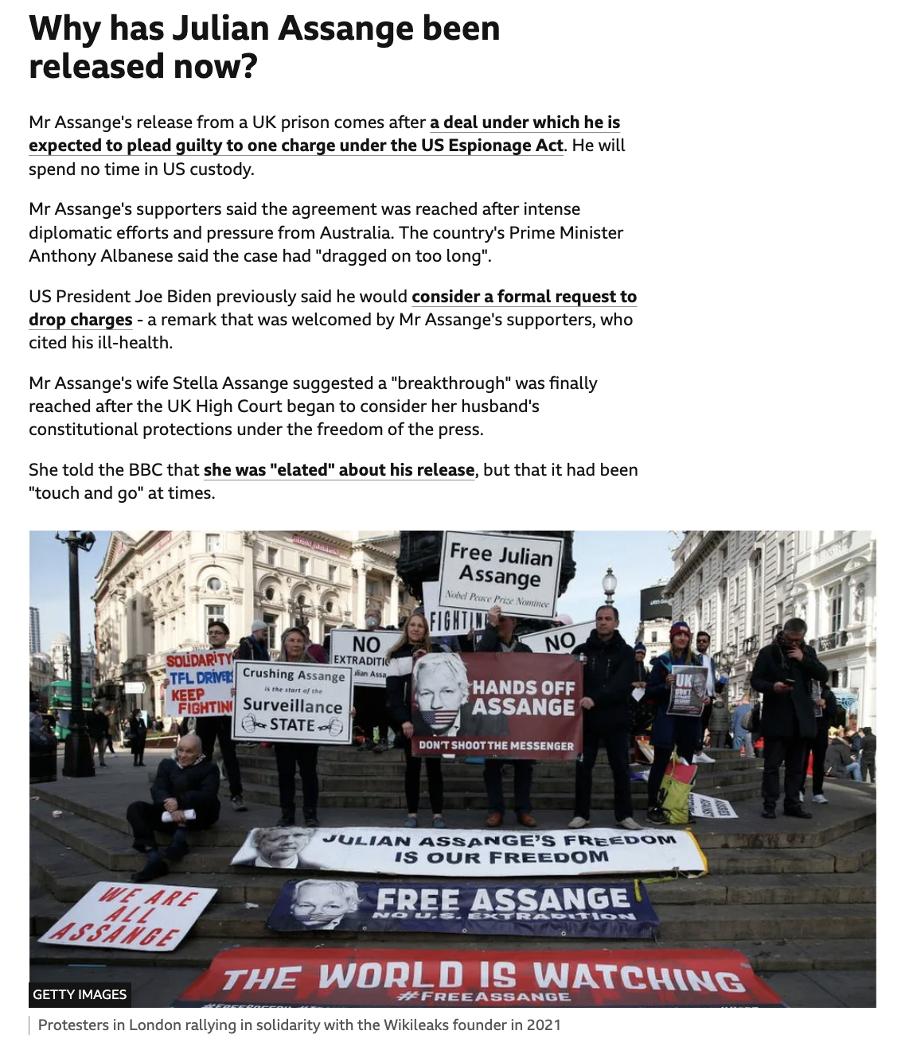
https://www.bbc.co.uk/news/world-us-canada-68282613

Slide 5
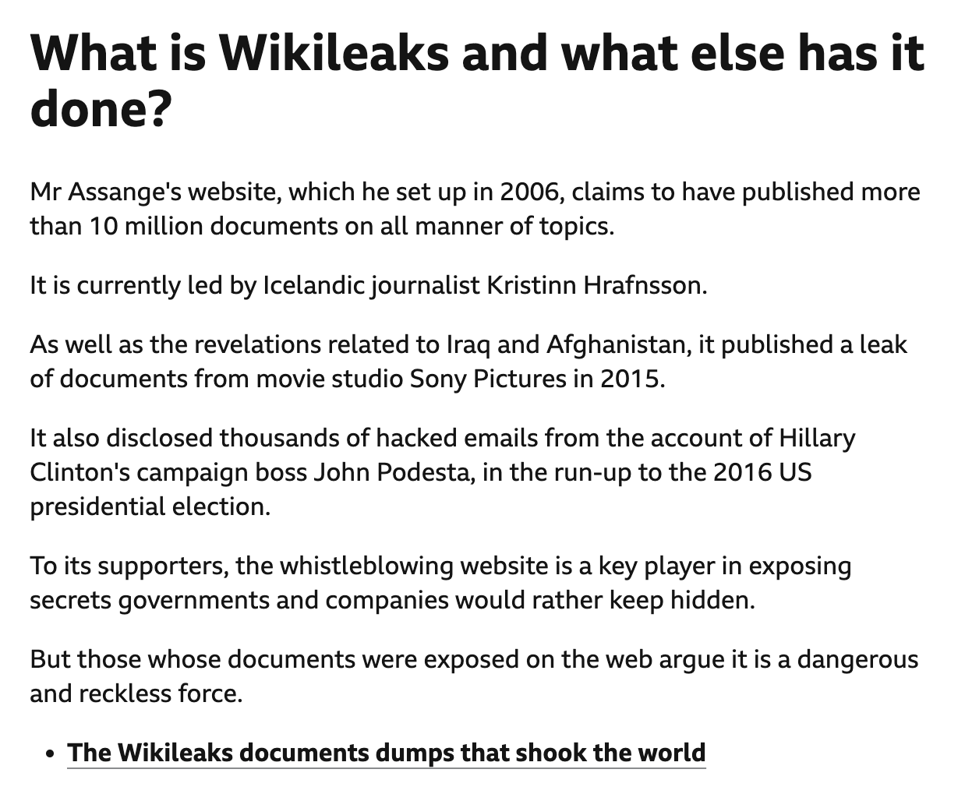
https://www.bbc.co.uk/news/world-us-canada-68282613

Slide 6
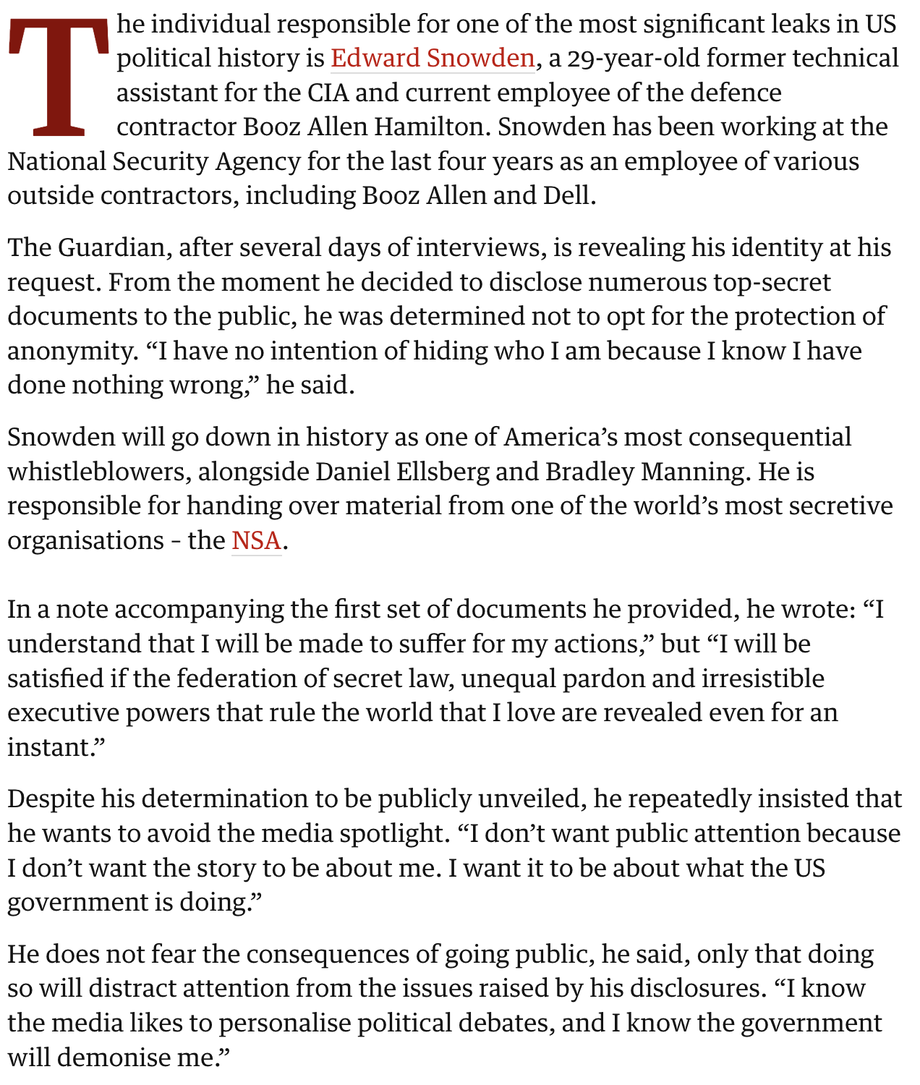
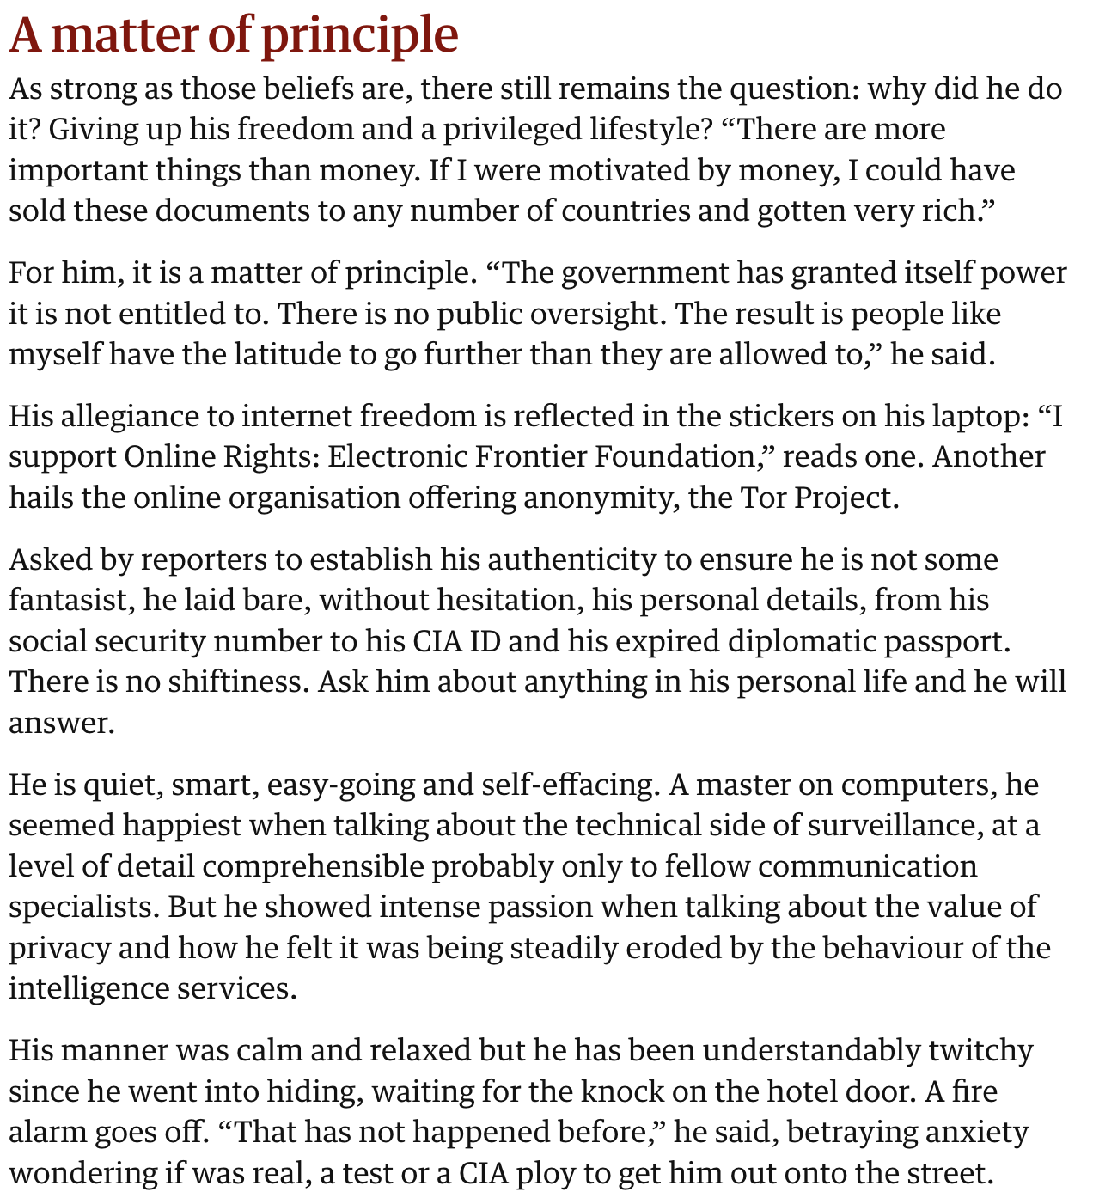
https://www.theguardian.com/world/2013/jun/09/edward-snowden-nsa-whistleblower-surveillance

